Slide 1

Ly Tu Trong College of Ho Chi Minh City
Bậc đào tạo: Cao Đẳng
Học phần: Anh Văn Chuyên ngành CNKT NHIỆT
Giảng viên: Nguyễn Thị Thanh Tú
Năm học: 2018 - 2019

Slide 2
Eric H. Glendinning
Norman Glendinning
Oxford English for Electrical and Mechanical Engineering

Slide 3

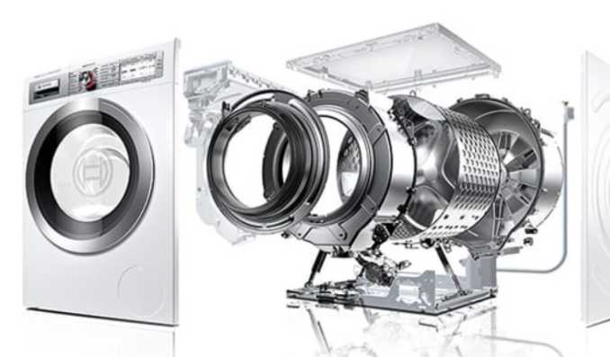
Unit 4: Washing machine
Task 1
Tuning-in:
Many items found in the home contain control systems. The washing machine is one of the most complex.List some of the factors the control system of a washing machine must handle. This diagram may help you.

Slide 4
Ly Tu Trong College of Ho Chi Minh City
Bậc đào tạo: Cao Đẳng
Học phần: Anh Văn Chuyên ngành CNKT NHIỆT
Giảng viên: Nguyễn Thị Thanh Tú
Năm học: 2018 - 2019

Slide 5
Eric H. Glendinning
Norman Glendinning
Oxford English for Electrical and Mechanical Engineering

Slide 6
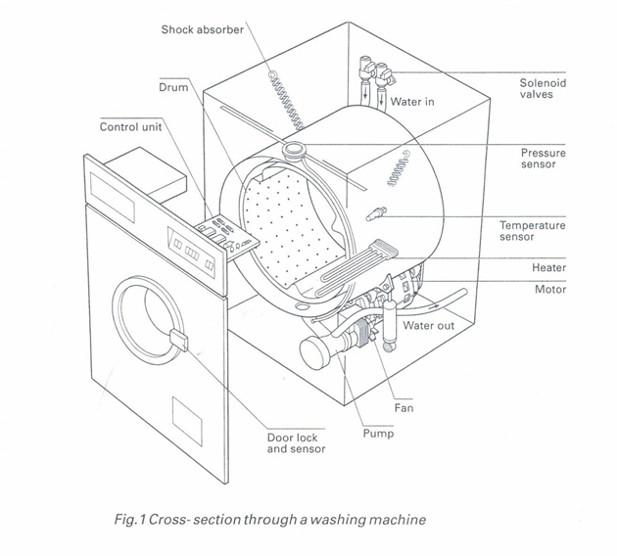
1. Shock absorber: bộ giảm sóc
2. Drum: lồng giặt
3. Control unit: bảng điều khiển
4. Water in: nước vào
5. Water out: nước ra
6. Pressure sensor: cảm biến áp suất
7. Temperature sensor: cảm biến nhiệt độ
8. Heater : bộ tăng nhiệt
9. Motor: động cơ
10. Fan: Quạt
11. Pump: bơm
12. Door lock and sensor: khóa cửa và cảm biến

Slide 7
II/ Reading:
Task 2 :
1.Pump: máy bơm
The pump with the task of transporting heat from the external environment to the receiving environment.
2.Motor: động cơ điện
Electric motors used to convert electrical energy into mechanical energy.

Slide 8
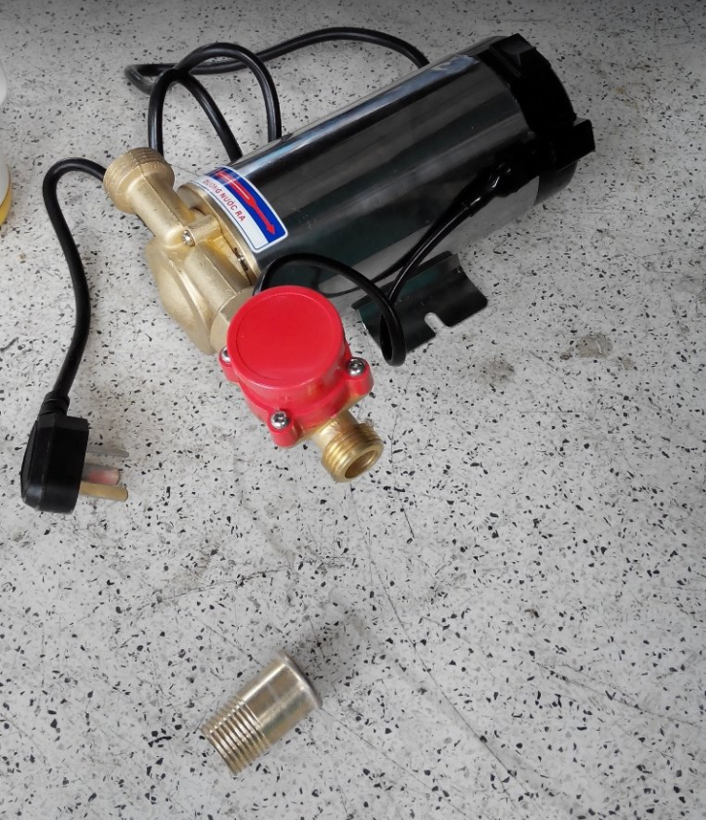
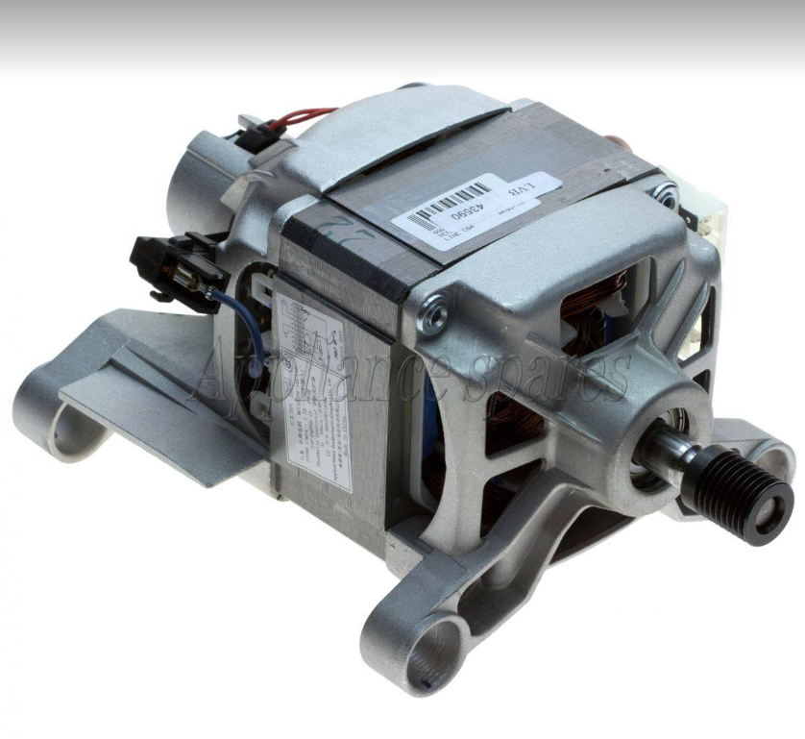

Slide 9
3.Shock absorber: bộ giảm xóc
Shock absorber used the anti-vibration, fixed vibration cage without vibration, make the machine operate smoothly and balanced when load and no load.
4.Solenoid valves: van điện từ
In case there is no current flowing, the spring compressor pressed into the iron core pushed the valve door closed. When there is current flowing through the wire coil, the coil is magnetized from magnetic field to form the suction force of the iron core, the magnetic force is large enough to overcome the spring to open the valve opening.

Slide 10
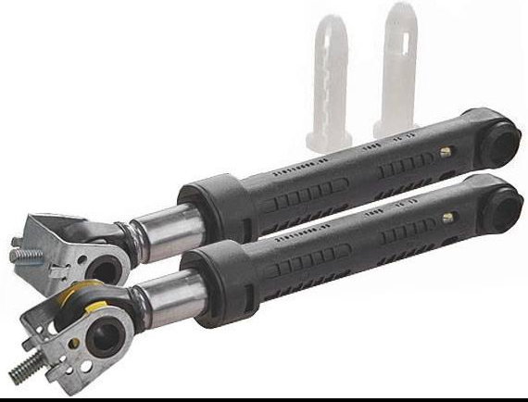
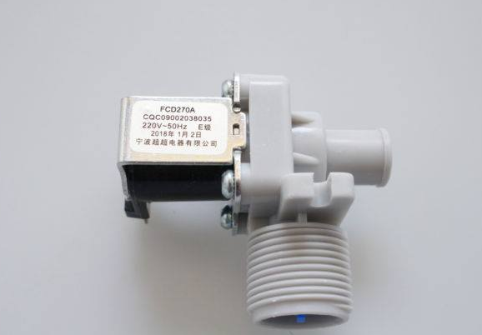

Slide 11
5.Heater: lò sưởi
The heating element is mounted on a fixed plate, fixed on the back of the inner cylinder. The coupling is fitted with a rubber gasket to prevent leakage of fluid.
6.Pressure sensor: cảm biến áp suất
Pressure sensor used for measuring air pressure, gas pressure, water pressure and pressure, steam pressure, boiler.

Slide 12
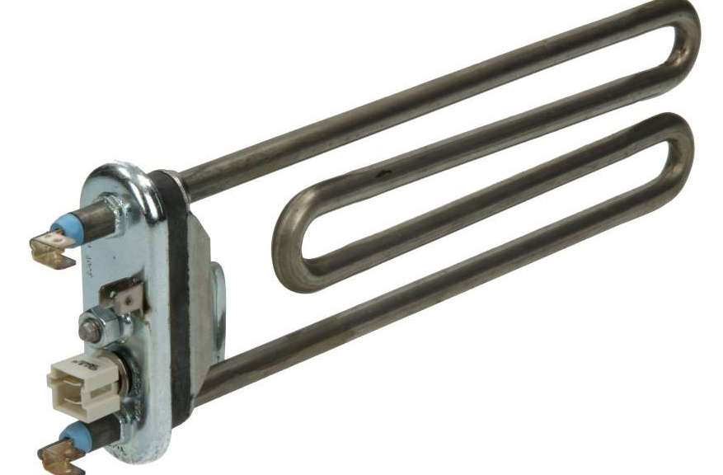
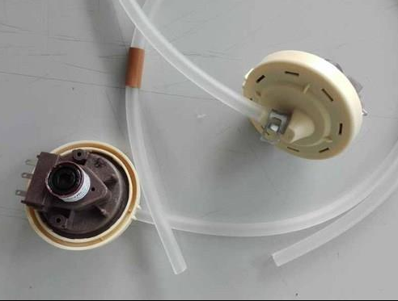

Slide 13
7.Door lock and sensor: khóa cửa và cảm biến
Door lock washing is also known as a door switch, which is responsible for closing the control circuit, which prevents the door from opening during the washing process and helps ensure safety for the user and the machine.
8.Temperature sensor: cảm biến nhiệt độ
A temperature sensor is a device that senses the variation of physical quantities that do not have electrical properties (temperature, pressure, flow,...) measured in terms of usually electrical quantities. Measure and process.

Slide 14
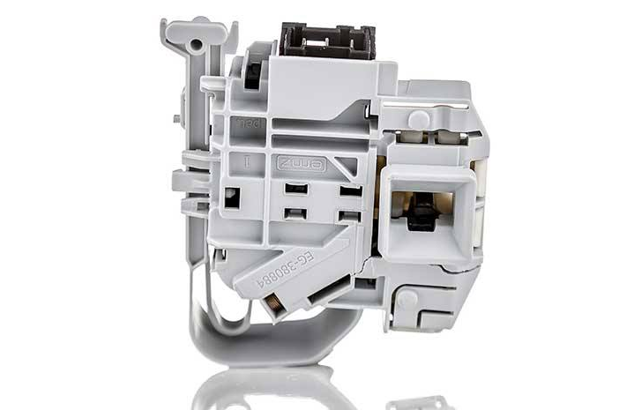
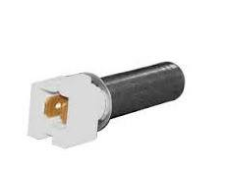

Slide 15
9.Fan: quạt
Fans bring a lot of special functions such as steam, spray mist,... makes using the fan easier and more comfortable.

Slide 16
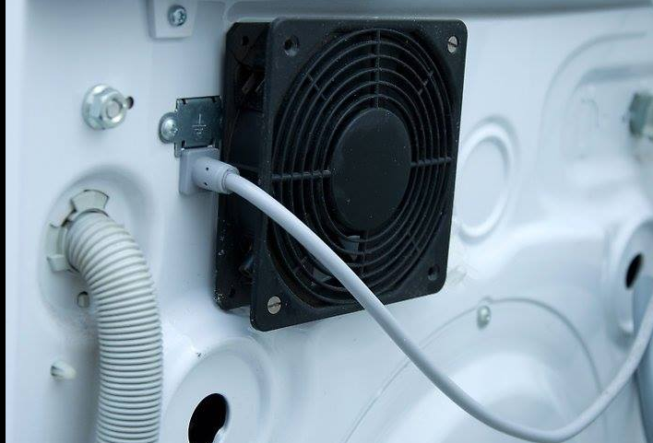

Slide 17
Control systems in the home.
Most devices in the home have some sort of control. For example, you can control the volume of a TV by using a remote control. The building blocks of a control system are:

Slide 18
The input can be any movement or any change in the environment. For example, a drop in temperature may cause a heating system to come on.
The control may change the size of the output (for example, adjusting the sound of a TV). Often this involves changing one kind of input into a different kind of output. For example, opening a window may set off a burglar alarm.

Slide 19


Outputs can be of many kinds. An alarm system may ring a bell, flash lights, and send a telephone message to the police.
Most control system are closed loops. That means they incorporate a way of checking that the output is correct. In other words, they have feedback. The thermostat in a heating system provides constant feedback to the control unit.
Temperature
Boiler/Pump
sensor
Control unit
Boiler switch
radiators
feedback

Slide 20
The control system of a modern washing machine has to take into account several different factors. These are door position, water level, water temperature, wash and spin times, and drum speeds. Most of them are decided, washing program to used.
Shows a block diagram of a washing machine control system. You can see that this a quite a complex closed loop system using feedback to keep a check on water level, water temperature, drum speeds.

Slide 21
The control unit the heart of the system. It receives and sends out signals which control all the activities of the machine. It is also capable of diagnosing faults which may occur, stopping the program, and informing the service engineer what is wrong. It is a small, dedicated computer which, like other computers, uses the language of logic.
.
Source: P. Fowler and M. Horsley, ‘Control systems in the home’, CDT: Technology

Slide 22
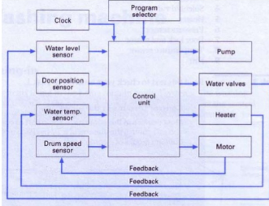

Slide 23
Task 4:
Read the following text to find the answers to these questions:
1.What device is used to lock the door?
(Thiết bị nào được sử dụng để khóa cửa?)
heats up a heat – sensitive pellet
2.What provides feedback to the control unit about the door position?
This expands as it gets hot, pushing a mechanical
lock into place and closing a switch.

Slide 24
Text 1
Door position
The machine will not start any program unless the door is fully closed and locked. When the door is closed, it completes an electrical circuit which heats up a heat – sensitive pellet. This expands as it gets hot, pushing a mechanical lock into place and closing a switch. The switch signals the control unit that the door is closed and locked. Only when it has received this signal will the control unit start the wash program.
Now work in pairs, A and B.
Complete your section of the table opposite. Then exchange information with your partner to complete the whole table.

Slide 25
 | Control factor | Operating device | Feedback by
1 | Door position
2 | Water level
3 | Water temperature
4 | Wash and spin times
5 | Drum speeds
Heat-sensitive pellet
Switch
Vales & Solenoid
Pressure sensor
Heater
Temperature sensor
The Control unit
Electronic clock
Motor
Speed Sensor
Picture

Slide 26
Text 2
Water level
When a wash program first starts it has to open the valves which allow the water in. there are usually two of the valves, one for hot water and for cold. Each must be controlled separately depending on the water temperature needed for that program. The valves are solenoid operated, i.e. they are opened and closed electrically.
The rising water level is checked by the water level sensor. This is a pressure sensor. The pressure of the air in the plastic tube rises as it is compressure by the rising water. The pressure sensor keeps the control unit informed as to the pressure reached and the control unit uses the information to decide when to close the water inlet valves.

Slide 27
Text 3
Water temperature
The temperature sensor, a type of thermometer which fits inside the washer drum, measures the water temperature and signals it to the control unit. The control unit compares it with the temperature needed for the program being used. If the water temperature is too low, the control unit will switch on the heater. The temperature sensor continues to check the temperature and keep the control unit informed. Once the correct temperature is reached, the control unit switches off the heater and moves on to the next stage of the program.

Slide 28
Text 4
Clock
The control unit includes a memory which tells it how long each stage of a program should last. The times may be different for each program. The electronic clock built into the control unit keeps the memory of the control unit informed so that each stage of each program is timed correctly.

Slide 29
Text 5 :
Drum speed (tốc độ quay trục ):
During the washing and spinning cycles of the program, the drum has to spin at various speeds. Most machines use three different speeds: 53 rpm for washing; 83 rpm for distributing the load before spinning; 100 rpm for spinning.
The control unit signals the motor to produce these speeds. The motor starts up slowly, then gradually increases speed. The speed sensor, a tachogenerator, keeps the control unit informed as to the speed that has been reached. The control unit uses the information to control the power to the motor and so controls the speed of the drum at all times.

Slide 30
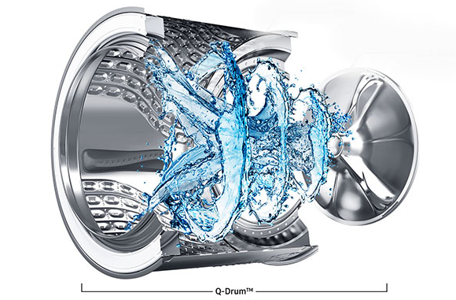
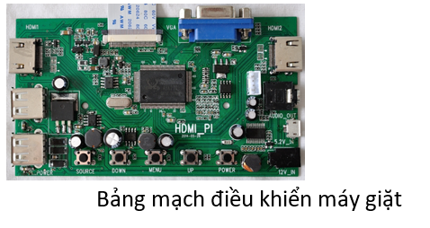

Slide 31
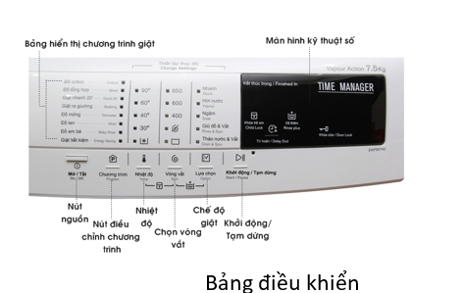
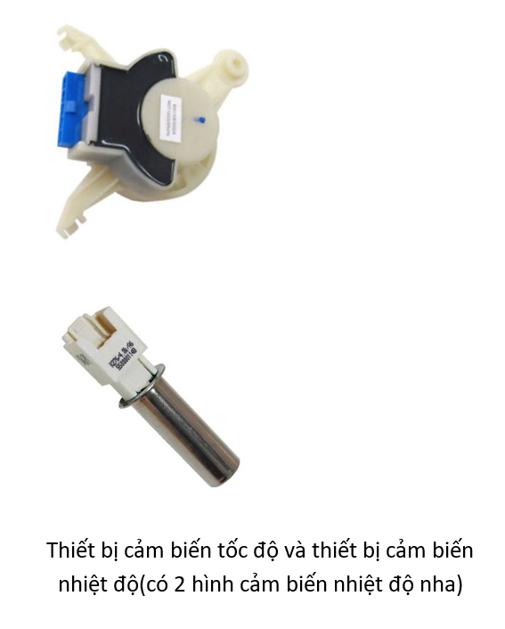
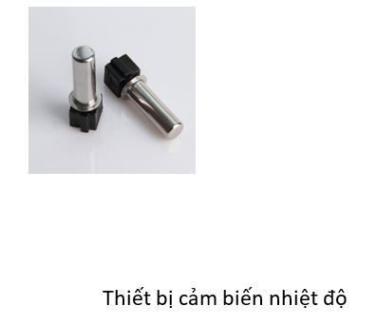

Slide 32
Unit 5: Heat transfer
Demonstration: Thermodynamics
Task 1: Read the demonstration and give some examples deal with the first law of thermodynamics:

Slide 33
Thermodynamics is that branch of science dealing with the mechanical action of heat. There are certain fundamental principles of nature, often called laws of thermodynamics, which govern our existence here on Earth, several of which are basic in the study of refrigeration.
The first and most important of these laws is the fact that energy can neither be created nor destroyed, but can be converted from one type to another. A study of thermodynamic theory is beyond the scope of this manual, but the examples that follow will illustrate the practical application of the energy law.

Slide 34
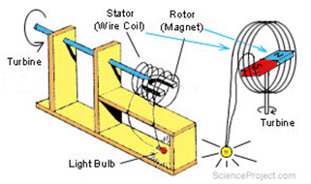
Example:

Slide 35
The second law of thermodynamics:
There are three mechanisms by which thermal energy is transported. What are they? Now read the text:
The second important law of thermodynamics is that heat always travels from a warm object to a colder one. The rate of heat travel is in direct proportion to the temperature difference between the two bodies.

Slide 36
Assume that two steel balls are side by side in a perfectly insulated box. One ball weighs one pound and has a temperature of 400⁰ F., while the second ball weighs 1,000 pounds and has a temperature of 390⁰ F. The heat content of the larger ball is tremendously greater than the small one, but because of the temperature difference, heat will travel from the small ball to the large one until the temperatures equalize.

Slide 37
Heat can travel in any of three ways: radiation, conduction, or convection.
Radiation is the transfer of heat by waves similar to light waves or radio waves. For example, the sun's energy is transferred to the Earth by radiation. One need only step from the shade into direct sunlight to feel the impact of the heat waves, even though the temperature of the surrounding air is identical in both places. There is little radiation at low temperatures, and at small temperature differences, so radiation is of little importance in the actual refrigeration process. However, radiation to the refrigerated space or product from the outside environment, particularly the sun, may be a major factor in the refrigeration load.

Slide 38
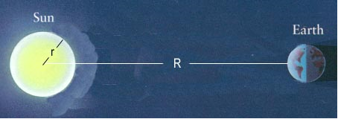
Radiation

Slide 39

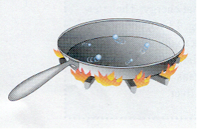
Conduction
Conduction is the flow of heat through a substance. Actual physical' contact is required for heat transfer to take place between two bodies by this means. Conduction is a highly efficient means of heat transfer as any service-man who has touched a piece of hot metal can testify.

Slide 40
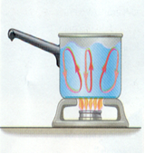
Convection is the flow of heat by means of a fluid medium, either gas or liquid, normally air or water. Air may be heated by a furnace, and then discharged into a room to heat objects in the room by convection.

Slide 41
In a typical refrigeration application, heat normally will travel by a combination of processes, and the ability of a piece of equipment to transfer heat is referred to as the overall rate of heat transfer. While heat transfer cannot take place without a temperature difference, different materials vary in their ability to conduct heat. Metal is a very good heat conductor, while asbestos has so much resistance to heat flow it can be used as insulation.

Slide 42
Exercise:
Answer the questions
Task 2: 1. Answer the questions:
1/ What is thermodynamics?
2/ What is the first law of energy?
3/ In the second law of thermodynamics, how does heat travel ?
4/ Name three ways in which heat can travel.

Slide 43
2. True or false
1/ Thermodynamics concerns the mechanical action of heat.
2/ Study of refrigeration is not in thermodynamics.
3/ Laws of thermodynamics do not govern our existence here on Earth.
4/ Energy can neither be created or destroyed.
5/ Heat will travel from the hotter small ball to the colder large one until the temperatures equalize.
6/ The sun's energy is transferred to the Earth by wave radio.
7/ Conduction is the flow of heat through a substance
8/ Convection is the flow of heat by means of air or water.
9/ Metal does not transfer heat better than asbestos.

Slide 44
THANK YOU FOR YOUR ATTENTION

